Slide 1
Redshift and Hubble’s Constant
Sam Grobelny, Sacha Wible, Wentao Zhong

Slide 2
Motivations
This project was to better understand Hubble’s constant by using data collected from the redshift of supernovae and otherwise prove the relevance of dark matter in an accelerating universe.

Slide 3
Methods and Assumptions
Error for the graph was lifted from the data
Linear equation was done by finding the slope and y intercept using polyfit
700 Mpc > Distance > 0 Mpc
H0 = V/D
y = mx + b
T = 1/H0

Slide 4
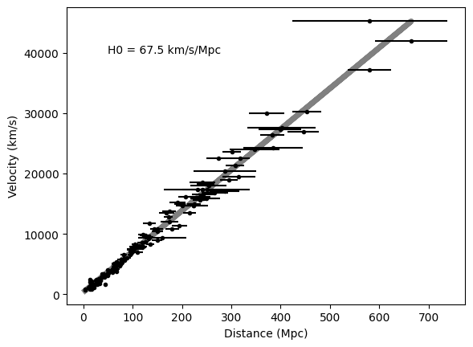
The Graph

Slide 5
Conclusion
Limiting the x and y range we find the slope of the line, and thus the Hubble’s Constant, to be around 67km/s/Mpc. When using this value to find the age of the universe (1/H0) we find the age of the universe to be around 14.43 billion years, which is a decent approximation.

Slide 6
Works Cited
Tonry, John L., et al. “Cosmological results from high‐z supernovae.” The Astrophysical Journal, vol. 594, no. 1, Sept. 2003, pp. 1–24, https://doi.org/10.1086/376865.

